Slide 1


Cuckoo Sandbox and
Dynamic Malware Analysis
Google Images
… Or am I “Cuckoo for Malware?”
Slides: https://github.com/lehuff/BSides_Philly
Presentation by:
Lane Huff
lhuff@secure-innovations.net
Twitter: @skankinmonkey

Slide 2
Agenda
Who am I?
What is Dynamic Malware Analysis?
What is Static Malware Analysis?
Cuckoo Overview
Hiding from Malware
Looking at Malware

Slide 3

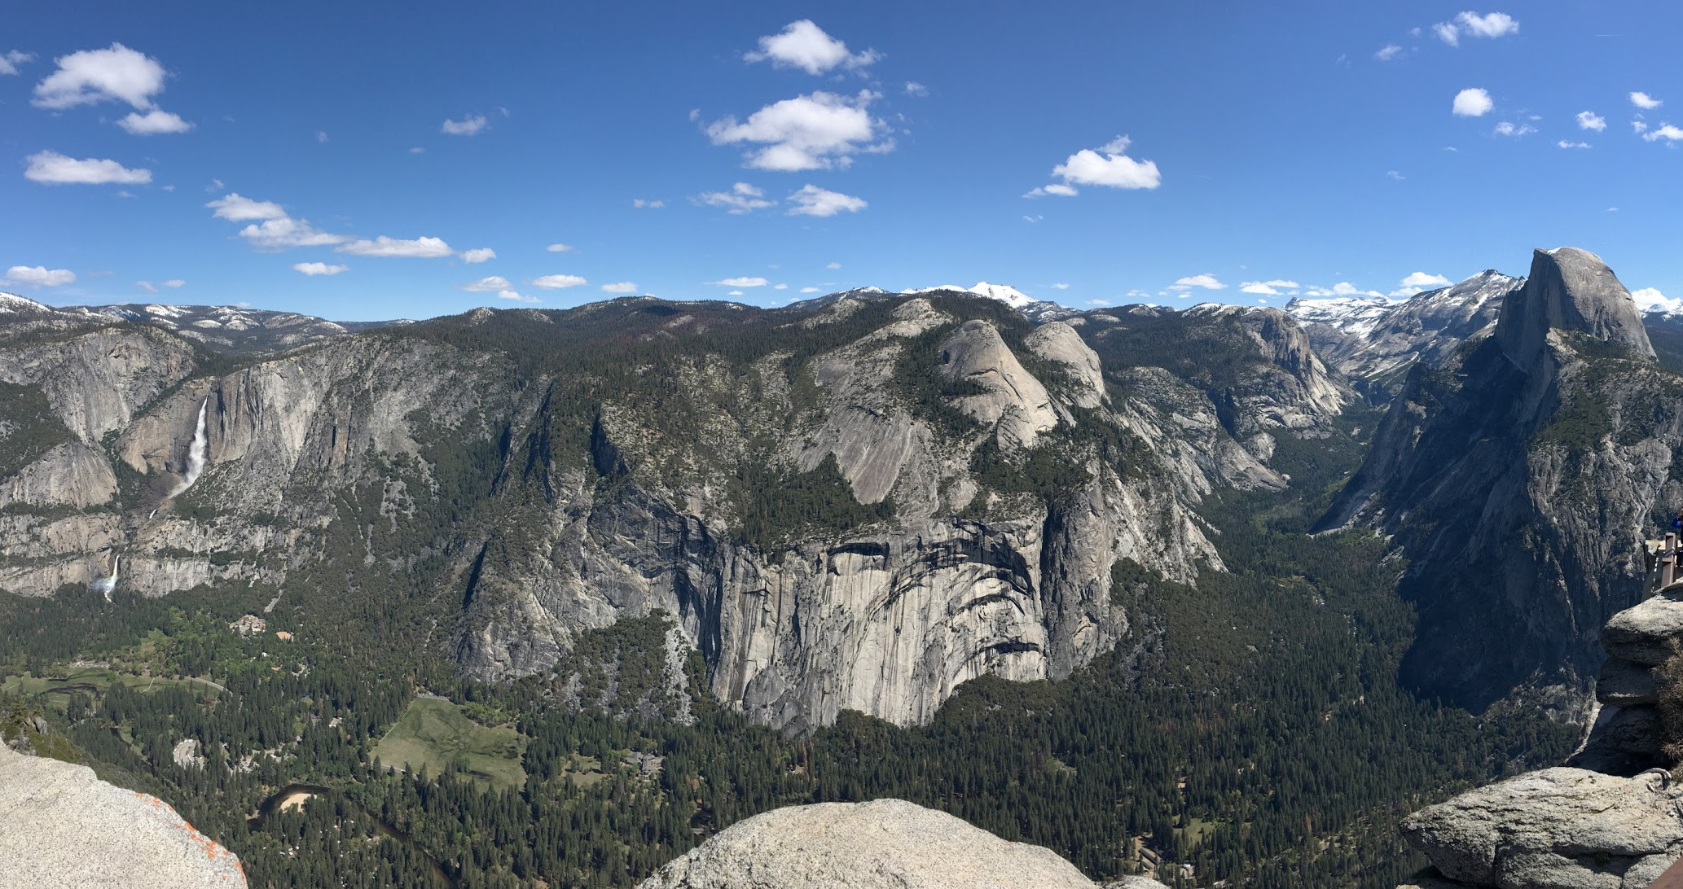
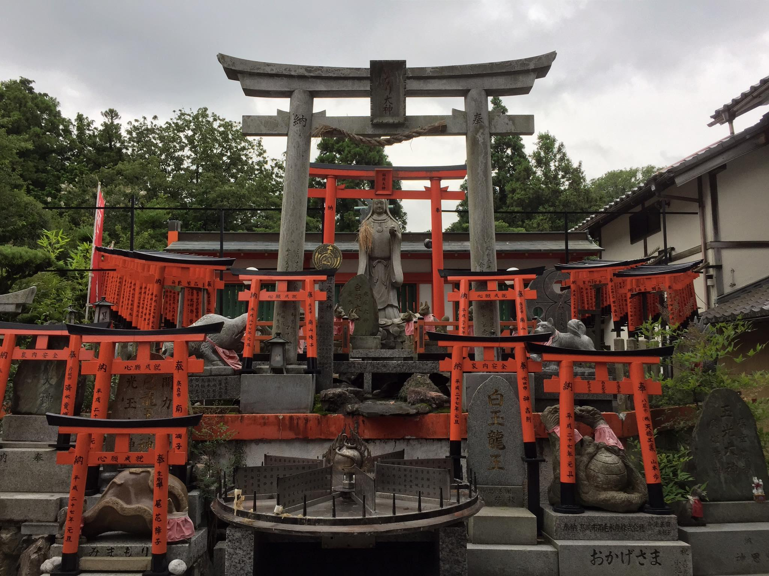
Who am I?
Lane Huff
Security Engineer at Secure Innovations
Blog Author & Podcast Participant with Primal Security
Open Source Contributor
World Traveler
Twitter: @skankinmonkey

Slide 4
What is Dynamic Malware Analysis?
It is Testing and Evaluating Programs in Real Time
Running an executable
Loading a DLL
Opening a document
Playing audio/video
Opening a zip file
...and much More!

Slide 5

But wait! …
… Let’s back up a little first!

Slide 6
Static Analysis
Static Analysis is analyzing a file at rest
It can be any of the files previously mentioned
Memory Dumps (Volatility)
Network Data (tcpdump/Wireshark)
Executables use debuggers
IDAPro
OllyDBG
Immunity

Slide 7
Static Analysis
File Metadata
Reported file/MIME-type
MD5/SHA values
Version
Company Name
Application Name
...lots of information

Slide 8
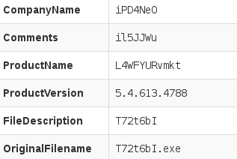
Static Analysis

Slide 9
Static Analysis
Signing Certificates
Is the file signed?
Who signed it?
Indicator of CA compromise?

Slide 10
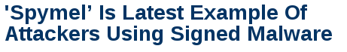
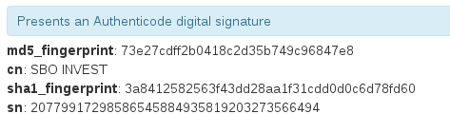
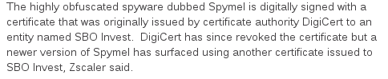
Static Analysis
http://www.darkreading.com/vulnerabilities---threats/spymel-is-latest-example-of-attackers-using-signed-malware-/d/d-id/1323805

Slide 11
Static Analysis
Development environment
Compile time
Original filename
Development environment
Host system remnants
Paths
System language

Slide 12
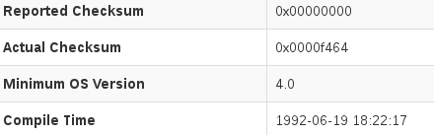

Static Analysis
Windows NT 4.0 RTM: July 31, 1996

Slide 13
Static Analysis
Compression/Obfuscation Tools
.NET Obfuscators
‘Weird’ variable names

Slide 14
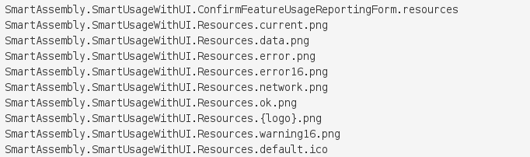
Static Analysis

Slide 15
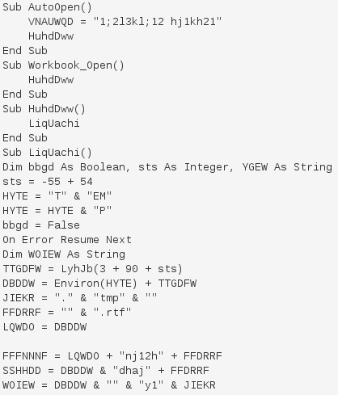
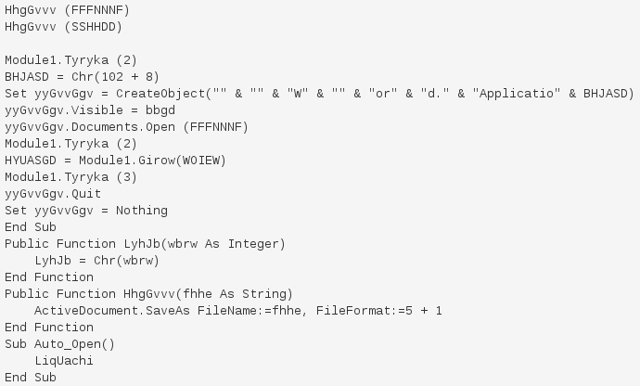
Static Analysis

Slide 16

… But what does the program actually do?
Google Images

Slide 17
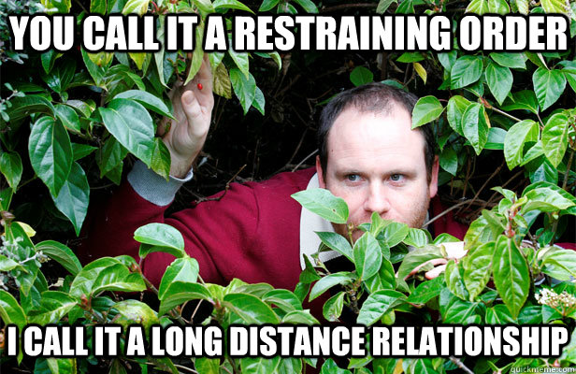
(Re)introducing Dynamic Analysis — Why?!
Obfuscation/Compression/ Encryption Techniques may mask true intentions of a file.
Malware authors don’t want to make analysis easy!

Slide 18
(Re)introducing Dynamic Analysis
Some options for dynamic analysis:
Run on your System!
Run on a VM
Run on an Isolated (Physical) System
*None of these options are ideal or easy to work with and are not very ‘dynamic.’

Slide 19

Cuckoo Sandbox
Malware Analysis Platform
WinXP (x86), Windows 7 (x86, x86_64 (beta))
Linux (beta)
Android (beta)
Sandbox Architecture
VirtualBox
KVM
VMWare Workstation
VMWare ESXi
XenServer
Bare Metal

Slide 20

Cuckoo Sandbox (cont.)
Registry Analysis
Process Analysis
Network Analysis
Memory Analysis*
Kernel Analysis
Dropped File Analysis
… and Static Analysis!
*Using Volatility

Slide 21
Architecture Challenges
Nesting Cuckoo
32-bit
Resource competition
Flat is more scalable
...but harder to manage (ESX)
Consider your goal!
Personal deployment?
Enterprise?
Sharing with friends?

Slide 22
How does it work?

Slide 23
To summarize…
Step 1:
Submit a file

Slide 24
To summarize…
Step 1:
Submit a file
Step 2:
Cuckoo sends file to a VM for execution

Slide 25
To summarize…
Step 1:
Submit a file
Step 2:
Cuckoo sends file to a VM for execution
Step 3:
Cuckoo performs analysis on the returned information

Slide 26
To summarize…
Step 1:
Submit a file
Step 2:
Cuckoo sends file to a VM for execution
Step 3:
Cuckoo performs analysis on the returned information
Step 4:
Reports are generated

Slide 27
Cuckoo Distributions
Main Distribution:
https://www.cuckoosandbox.org/
Brad Spengler’s 1.2 Fork (Spender-Sandbox):
https://github.com/spender-sandbox/cuckoo-modified

Slide 28
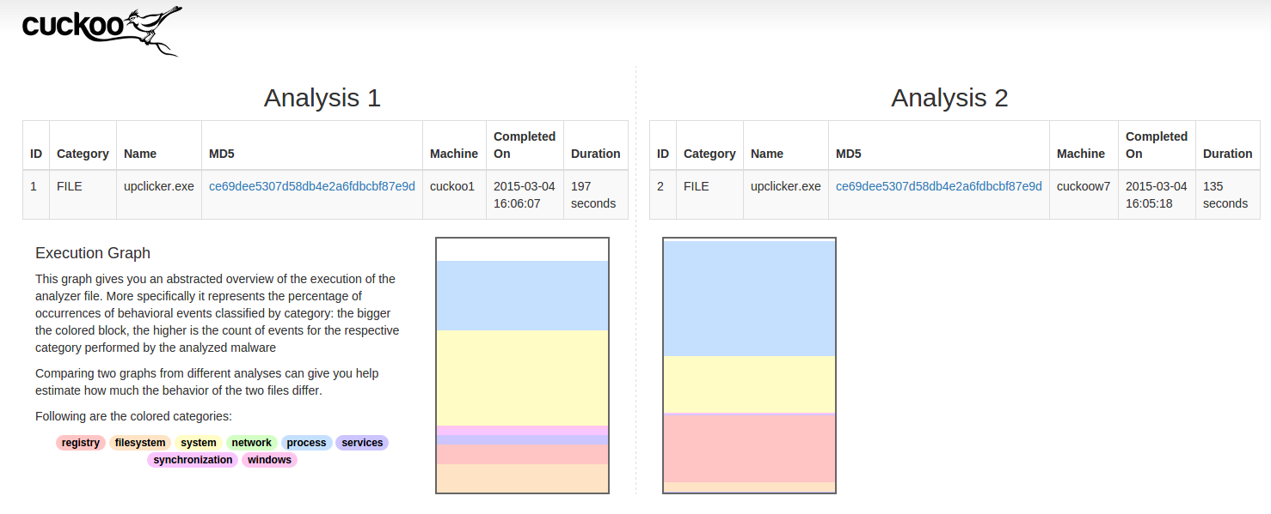
Cuckoo Forks Unique Features
Cuckoo 1.2
32-bit Windows Analysis only
Good documentation
Community Signatures (not actively maintained anymore)
Stable!
Old (March 2015)
Execution graph

Slide 29
Cuckoo Features
Cuckoo 2.0 RC2
32/64-bit Windows support
Android/OSX/Linux support (no documentation yet)
Import/Export reports
Maintained set of Community Signatures
Suricata/Snort Integration
MITM support for Encrypted Traffic
Malware Scoring support (very bad right now)
Sandbox Baselining (memory-only)

Slide 30
Cuckoo Forks Unique Features
Spender Sandbox
All the Features of 1.2 plus …
32/64-bit Windows support
Normalized Registry Names
Service monitoring
Better signatures (and maintained!)
Per-Analysis commenting
Better at evading Anti-Sandbox and Anti-VM tools
Malware Scoring (pretty good)
Very stable and good documentation
… and more! (regular updates to Git.)

Slide 31
Comparison
Feature | 2.0 RC2 | Spender
32/64bit Windows 7 | ✓ | ✓
Android/OSX/Unix | ✓ | x
Community Signatures | ✓ | ✓
Suricata/Snort Integration | ✓ | ✓
Normalized Registry Keys | x | ✓
Commenting | x | ✓
Scoring | ✓ | ✓
Baselining | ✓ | x

Slide 32
Analysis Packages
(Java) applet
bin(ary data)
Cp1 (control panel applets)
Dll
Doc (Word)
Exe
Generic (via cmd.exe)
HTML
IE (for URL)
Jar
MSI
PDG
PPT
PS1 (Powershell)
Vbs (VBScript)
Xls (Excel)
Zip
… Automatic Detection (usually)

Slide 33
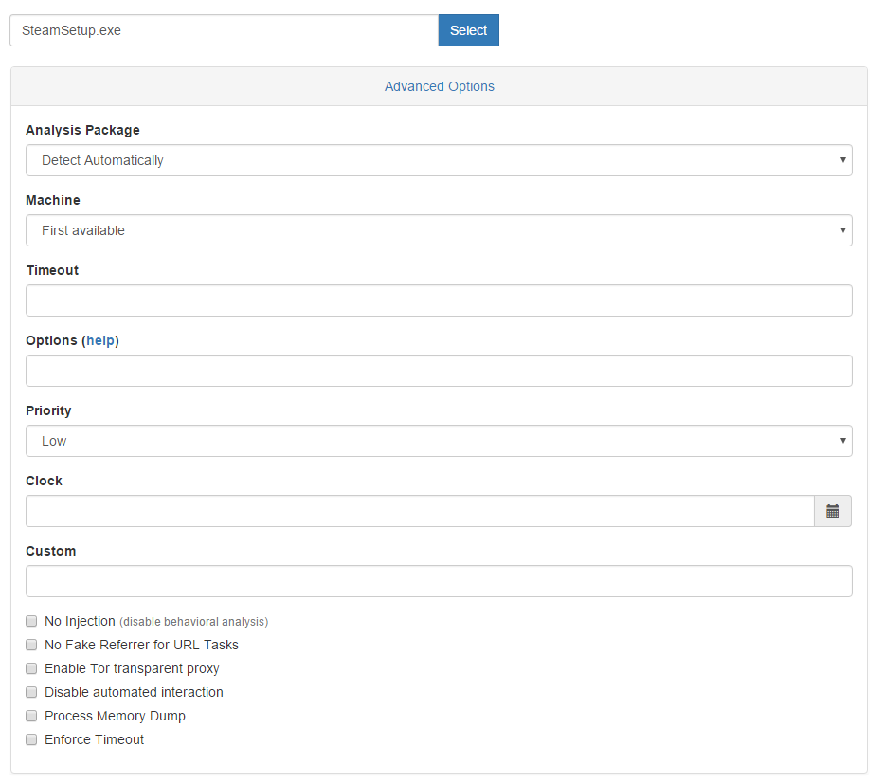
Submission Options
Package Selection
Machine Selection
Override Timeout Value
Set Clock Options (Spender-Only)
Disable VM-Interaction
Memory Analysis

Slide 34

Overview Page
File Details
SSDEEP
Yara
Signatures
Community based
Customizable
Severity
Network Traffic (DNS/Host)
File/Process/Registry activity

Slide 35
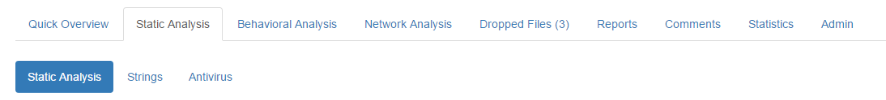
Static Analysis Page
PE Information
Reported/Actual Checksum
Compile Time
Version Information
File metadata (author, etc)
Memory Sections
Virtual Size/Raw Size
Imports
Kernel, other system calls
Strings
Antivirus (VirusTotal)

Slide 36
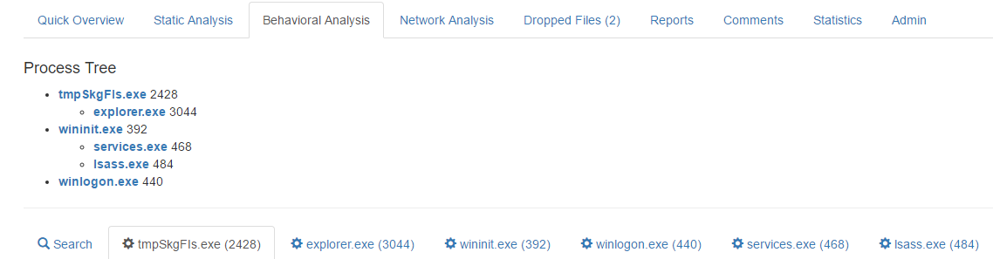
Behavioral Analysis Page
Process Tree
Useful for viewing execution flow
Per process ‘action’ breakdown

Slide 37
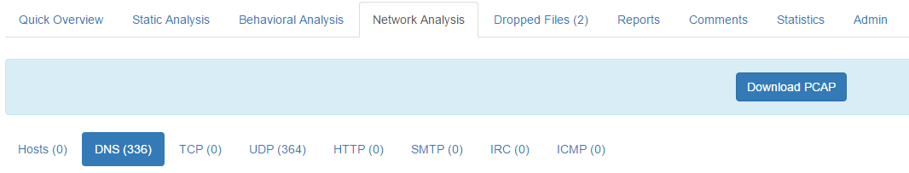
Network Analysis Page
Breakdown by Type of Traffic
Post-Analysis Lookup (via VirusTotal)
Can view Packet Information (Useful for plaintext Data!)
Downloadable PCAP File

Slide 38
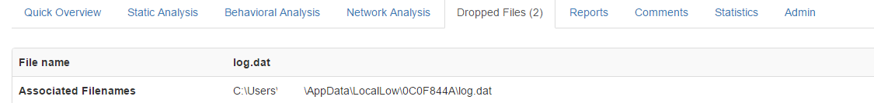
Dropped Files Page
List of Files Created during Execution of Submitted File
Similar Information to Static Analysis Page
Search VirusTotal for File
Download Dropped File for Submission

Slide 39
Additional Pages
Reports
Download generated reports for the analysis
JSON
HTML
Summary HTML
PDF
..and more if set in reporting.conf
Comments
Per-analysis notes
Statistics
Speed of Modules, Signatures, Reports
Admin
Job ID
Mongo DB ID
Delete Job

Slide 40

Let’s change gears again!

Slide 41

Malware authors are smart.
They know we’re looking for them!
What are some methods used to detect analysis?

Slide 42
Indicators for Sandbox/Analysis
Process Names
Registry Entries
Device Names
MAC Addresses
Default System Settings
IP Addresses
Auto-Start Entries
Start Menu Items
Date/Time
(This list is always growing and methods are being changed.)

Slide 43
Detection Countermeasures
Manually Sanitize:
VM-Related Registry Keys
Device Names
Change MAC address to a ‘Physical’ Device Address
Don’t Install VMWare Tools/VirtualBox Additions
Make your System Look ‘Used’
Install Applications
Use the Browser Some
Multiple Users on a System
More than 1 CPU
More than 2GB of RAM

Slide 44
Detection Countermeasures
VMCloak
Automated Virtual Machine Generation and Cloaking for Cuckoo Sandbox
Can install Various Versions of Windows (XP, 7, 8, 10) and OSX
Can add Optional Applications on top of installation
Adobe
.NET
Office
...and more!
Applies a Set of Configuration Options to Avoid VM/Sandbox Detection
Can automatically add the VM to your Cuckoo install
More info: http://jbremer.org/vmcloak3/
Download: https://github.com/jbremer/vmcloak

Slide 45
Verify your Anti-Anti-Countermeasures!
PAFish (Paranoid Fish)
Executable which emulates Anti-Analysis/Sandbox Techniques
Submit to your Sandbox and View Results to see where your VM lacks
Not updated often, but still useful
Download: https://github.com/a0rtega/pafish

Slide 46
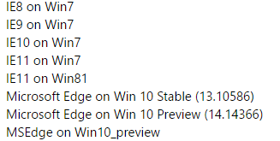
One Last Note on VMs
Malware Behaves Differently in Different Environments (Shocking!)
Thorough analysis requires multiple environments for testing
Different software loads (Adobe 9, 10, WinZip, 7Zip, etc.)
Different versions of Internet Explorer; Other Web Browsers
Try with and without EMET
Microsoft provides some useful images for testing different browsers:
https://developer.microsoft.com/en-us/microsoft-edge/tools/vms/

Slide 47

Let’s Look at Malware!

Slide 48
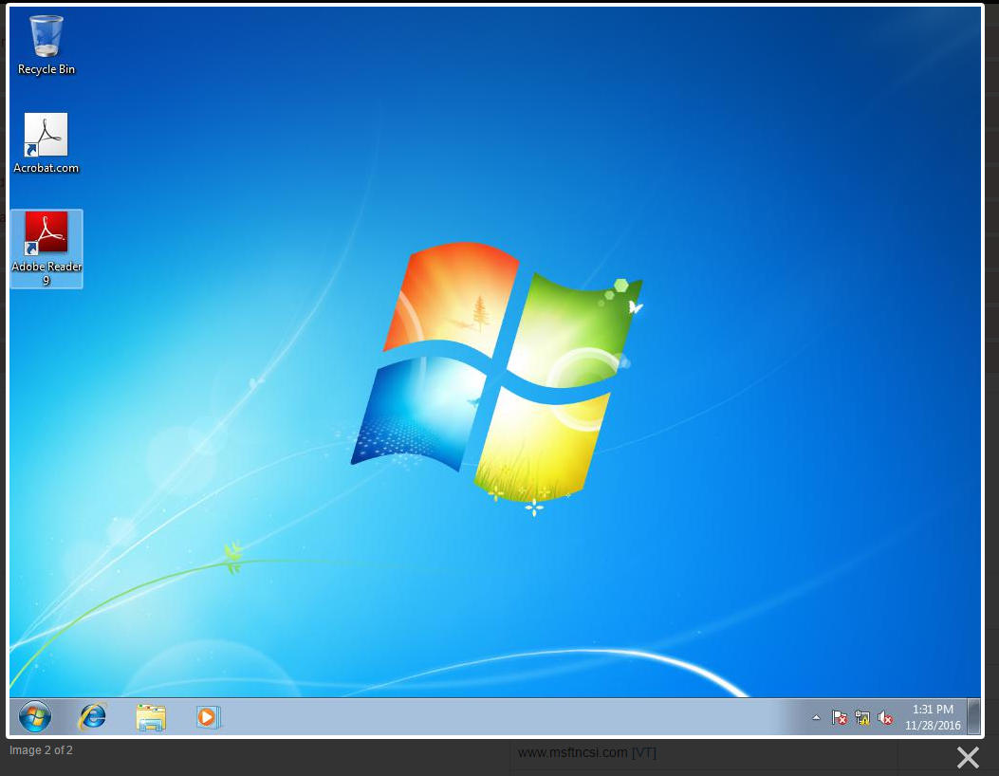
News.exe
Sha256: 039058cd0f349c8987a4a61a3de12660b78007235126ee75228933fda2343e4f

Slide 49
News.exe
Sha256: 039058cd0f349c8987a4a61a3de12660b78007235126ee75228933fda2343e4f
‘Syrian Malware’ (Bladabindi Backdoor)
Static Information:
Compile Time: 2014-10-05 16:05:59
LegalCopyright: Copyright \xa9 2005
InternalName/OriginalFilename: 5.exe
Sandbox Results:
DNS Call: aliahmahhmod.zapto.org
Multiple Startup Registry Keys created
Invokes user32.dll.GetAsyncKeyState - Keylogger!

Slide 50
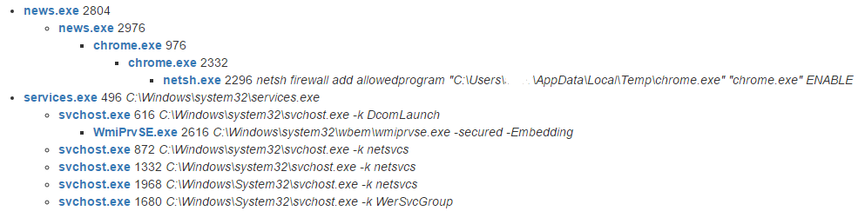
News.exe
Sha256: 039058cd0f349c8987a4a61a3de12660b78007235126ee75228933fda2343e4f
Execution Tree

Slide 51
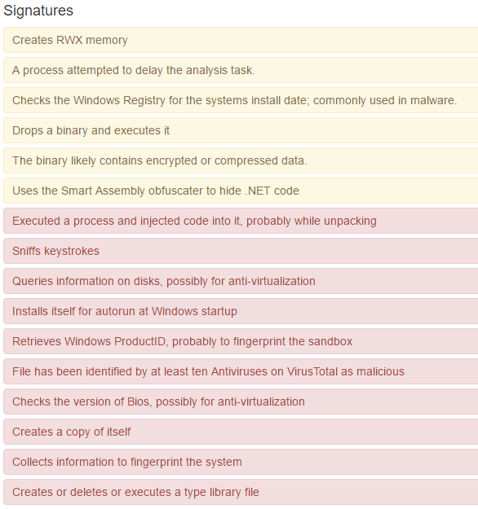
News.exe
Sha256: 039058cd0f349c8987a4a61a3de12660b78007235126ee75228933fda2343e4f

Slide 52

Loader.exe
sha256: ffb4a81fc336b1d77c81eef96eab0a5249ebb053c8920dd0c02e1d9f3ac257b0
Chimera Ransomware
Accessed file lists spider important directories
For every deleted file there is a new file
With a .crypt extension!
Also: YOUR_FILES_ARE_ENCRYPTED.HTML

Slide 53
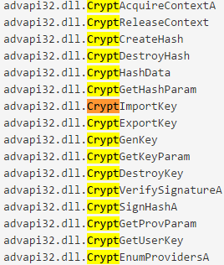
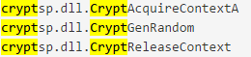
Loader.exe (26)
Chimera Ransomware
Static IP calls
Attempts to identify local system public IP address
Windows crypto functions utilized:
Advapi32.dll
cryptsp.dll

Slide 54
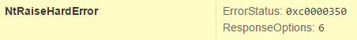
Autohotkey.exe
sha256: e03e2d150b8135cfb330394c35f9bf372801b8a7c52a7a271db0a4ee46abbdd7
Petya Ransomware
Scans drive for Antivirus
Modifies \??\PhysicalDrive0
Similar Crypto calls to Chimera
Invokes ntdll.dll.NtRaiseHardError

Slide 55
Autohotkey.exe
sha256: e03e2d150b8135cfb330394c35f9bf372801b8a7c52a7a271db0a4ee46abbdd7
Petya Ransomware
\??\PhysicalDrive0 - What is this?
Modified Bootloader
Crash Host, Reboot (NTRaiseHardError)
Custom Kernel which encrypts system on Startup
Cuckoo 2.0 RC2 - Analysis Reboot Survival (beta)
More info on Petya: https://blog.malwarebytes.com/threat-analysis/2016/04/petya-ransomware/

Slide 56

This is just the beginning!
There is so much more
out there to learn.

Slide 57
Useful Resources
Malware Analyst's Cookbook
Practical Malware Analysis
The Art of Memory Forensics
Twitter:
@PhysicalDrive0 - Cool Malware Resource
@skier_t - Cuckoo Author
@botherder - Cuckoo Author
@skankinmonkey - Me!
Reddit: /r/malware /r/netsec
http://www.primalsecurity.net/ Blog and Podcast!
https://infosecspeakeasy.org/

Slide 58

Questions?
Lane Huff, Security Engineer
lhuff@secure-innovations.net
Twitter: @skankinmonkey
Blog/Podcast: http://www.primalsecurity.net/
Slides: https://github.com/lehuff/BSides_Philly
Google Images

